Slide 1
Therapeutics in oncology

Slide 2
Therapeutics in oncology
Anti-cancer therapy may be either curative or palliative
curative intent:
complete cure of the cancer
suppressing the cancer to a subclinical state and maintaining that state for years of good quality of life (that is, treating the cancer as a chronic disease)
palliative care
No cure, for advanced-stage metastatic cancers, symptom control

Slide 3
Anticancer treatment goals
Palliative therapy
Managing metastatic disease
symptom control
improve the quality of life
May prolong survival
Adjuvant therapy
given after an initial therapy ex: after surgery where all the macroscopic disease has been removed
To treat miocrometastasis and decrease the risk of relapse

Slide 4
Neoadjuvant therapy
is where systemic therapy or radiotherapy are given before the main treatment
advantages :
May decrease the need for surgery
increase the chance of successful debulking
reduce the duration of hospitalisation
improve the fitness of the patient prior to interval debulking
Assess in measuring responses to treatment

Slide 5
Chemoprevention
Is the use of pharmacological agents to prevent cancer developing in patients identified as being at particular risk

Slide 6
Treatment modalities for cancer
Surgical treatment
Systemic chemotherapy
Radiation therapy
Hormone therapy
Immunotherapy
Biological therapies

Slide 7
Surgical treatment
Surgery has a essential role in the management of cancer, especially solid organs tumour.
The main indication:
Biopsy (diagnostic)
a histological or cytological diagnosis of cancer to determine tumour type and differentiation, staging ,and to assist subsequent management.
Cytology ----- FNA
Surgical biopsy ---- core biopsy (an image-guided biopsy) or an excision biopsy

Slide 8
Excision
Surgery may be performed before or after other forms of treatment
It is curative management of most solid cancers ex: early, localised cases of colorectal, breast and lung cancer
outcome is related to surgical expertise, and
most multidisciplinary teams include surgeons experienced in the management of a particular cancer.

Slide 9
Palliation
Palliative surgery used to relief the cancer symptoms in terminal stage and so improve the quality of life either by resection or bypass with out cure.
Surgical procedures are often the quickest and most effective
way of palliating symptoms, Ex:
gastrojejunostomy - pyloric obstruction from an advanced CA stomach
colectomy of a bleeding Ca colon in the presence of metastases
defunctioning colostomy for faecal incontinence
decompression of spinal cord compression
Resection of residual masses after chemotherapy
resection of metastases.

Slide 10
Systemic chemotherapy
The use of anti-cancer drugs which usually refers to as cytotoxic drugs
Generally affect rapidly proliferating cells
interfere with cell division in various ways, Ex: with the DNA duplication or the separation of newly formed chromosomes
Chemotherapeutic agents are not specific for cancer cells, and the side-effects of treatment are a result of their antiproliferative actions in normal tissues such as the bone marrow, skin and gut

Slide 12
Radiation therapy (radiotherapy)
treating the cancer with ionising radiation; it can be curative for some localised cancers
it can be delivered from the radioactive isotopes or by high-energy radiation beams (X-ray) Three methods are usually employed:
Teletherapy
Brachytherapy
Intravenous injection of a radioisotope

Slide 13
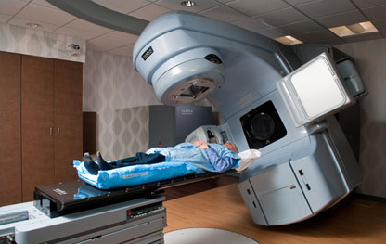
External beam radiotherapy (EBRT) or teletherapy
application from a distance by a linear
accelerator.

Slide 14
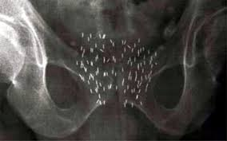
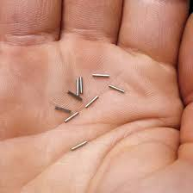
Brachytherapy:
direct application of a radioactive source on to or into a tumour.
Advantages: local delivery of a very high radiation dose
Ex: management of locally advanced prostate cancer cancers, head and neck cancer, CA cervix and endometrium

Slide 15
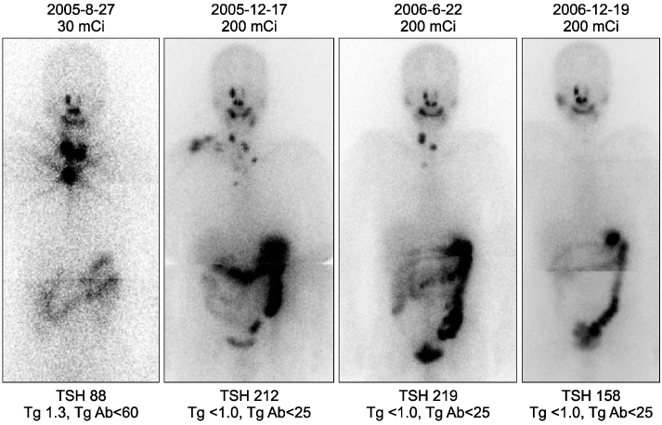
Intravenous injection of a radioisotope 131iodine for the thyroid cancer 89strontium for the treatment of bone metastases from prostate cancer

Slide 16
The biological effect of ionising Radiation?
Is to cause damage to DNA.
Since normal tissues are also radiosensitive, treatment has to be designed to maximise exposure of the tumour and minimise exposure of normal tissues.
This is possible with modern imaging techniques such as CT and MRI, which allow better visualisation of normal and tumour tissue

Slide 17
In addition, techniques such as conformal radiotherapy, in which shaped rather than conventional square or rectangular beams are used, allow much more precise targeting of therapy to the tumour, and reduce the volume of normal tissue irradiated by up to 40% compared to non-conformal techniques.

Slide 18
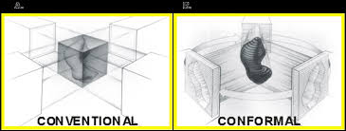
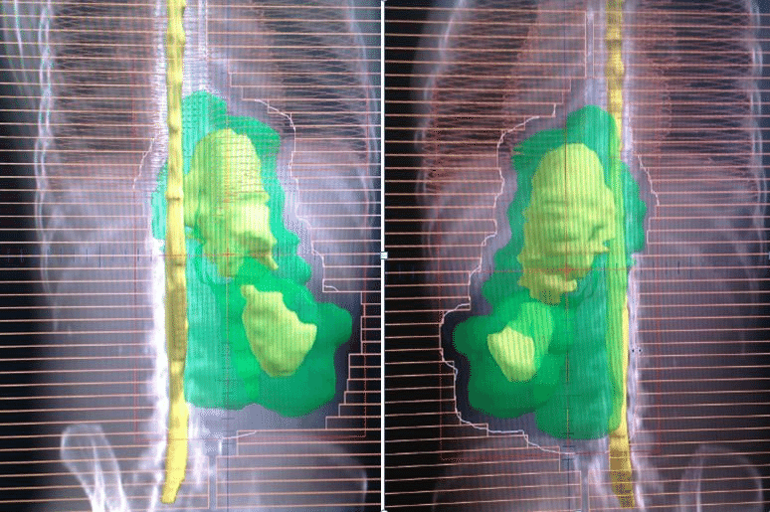

Slide 19
Biological differences between normal and tumour tissues are used to obtain therapeutic gain.
radiation usually delivered as a number of small doses on a daily basis (fractions)
This allows normal cells to recover from radiation damage but recovery occurs to a lesser degree in malignant cells
Normal tissue also varies in its radiosensitivity, the central nervous system, small bowel and lung being among the most sensitive

Slide 20
Fractionation regimens
Ex: radical treatments given with curative intent are usually delivered in 20–30 fractions given daily on 5 days a week, over 4–6 weeks
palliative radiotherapy can be given in smaller number of fractions (1–5)

Slide 21
Adverse effects of radiotherapy
localised acute inflammatory reaction Ex: skin reactions as in breast cancer, proctitis and cystitis in case of CA bladder or prostate
Late effects of radiotherapy develop 6 weeks or more after treatment and occur in 5–10% of patients, Ex:
brachial nerve damage and subcutaneous fibrosis – breast cancer
shrinkage and fibrosis-bladder cancer
Development of secondary malignancy Ex: breast cancer in survival of Hodgkin disease treated with radiotrherapy

Slide 22
Hormone therapy
most commonly used in the treatment of breast and prostate cancer
Breast cancer that are positive for expression of the oestrogen receptor (ER) respond well to anti-oestrogen therapy that reduce oestrogen levels or block the oestrogen receptors
adjuvant hormone therapy are used to reduces the risk of relapse and death and in advanced cases can induce prolong disease remissions with acceptable toxicity

Slide 23
In prostate cancer, hormonal therapy
(e.g. luteinising hormone releasing hormone (LHRH) analogues such as goserelin and/or anti-androgens such as bicalutamide) reduce androgen levels and maintain good long-term control of advanced disease
Progestogens
Used for treatment of endometrial. In the metastatic setting, progestogen use (ex: megestrol acetate) is associated with response rates of 20–40%
in endometrial cancer

Slide 24
Immunotherapy
A profound stimulus to the patient’s immune system can sometimes alter the natural history of a malignancy
Interferons are active in melanoma and lymphoma
IL-2 for renal cell carcinoma (RCC)
Rituximab, an antibody against the common B-cell antigen CD20 for treatment of NHL
Pemberolizumab for metastatic melanoma and lung cancer
Nivolumab for metastatic lung ,head and neck and kidney cancer.

Slide 25
Biological therapies
Are treatments that block the signalling pathways responsible for the growth of specific tumours.
This target cancer cells more selectively, with reduced toxicity to normal tissues. Ex:
Gefitinib/erlotinib/afatinib
These agents inhibit the activity of the EGFR, which is overexpressed in many solid tumours like non small cell lung cancer

Slide 26
Imatinib
Imatinib inhibit the BCR-ABL gene product, tyrosine kinase, It is effective for treatment of CML, malignant gastrointestinal stromal tumour (GIST)
Bevacizumab
is a humanised monoclonal antibody that inhibits vascular endothelial growth factor A (VEGF-A), a key stimulant of tumour angiogenesis. Bevacizumab has activity in colorectal, lung, breast, renal and ovarian cancers

Slide 27
Trastuzumab
Trastuzumab (Herceptin) targets the HER2 receptor, an oncogene that is over-expressed in 1/3 of breast cancers and in a number of other solid tumours (e.g. gastric cancer. Unfortunately, trastuzumab can induce cardiac failure by an unknown biological mechanism, especially in combination with doxorubicin.

Slide 28
Late toxicity of therapy
Recent advances in the treatment multimodalities of cancer and the curative intent for therapeutic administration have led to increase in the no. of cancer survival and patients are living longer
Late toxicity from chemo or radiotherapy is an important cause of morbidity
Ex: radiotherapy can retard bone and cartilage growth, impair intellect and cognitive function, and cause dysfunction of the hypothalamus, pituitary and thyroid glands

Slide 29
Late consequences of chemotherapy include
heart failure due to cardiotoxicity Ex: Doxorubicin
pulmonary fibrosis Ex: Bleomycin
nephrotoxicity: Cisplatin
Neurotoxicity Ex: Docetaxel

Slide 30
Premature gonadal failure subsequently subfertile can be caused by chemo. or radiotherapy
store sperm for male patients
Egg or embryo banking pre-treatment
in vitro fertilisation
Sterility and erectile dysfunction - high radiotherapy doses to the pelvis Ex: Ca prostate
Infertility and pubertal delay are late effects of therapy in children

Slide 31
Secondary AML follow chemoradiation:
occur 1–2 years after treatment with topoisomerase II inhibitors (irinotecan, topotecan)
or 2–5 years after treatment with alkylating agents (chlorambucil, cyclophosphamide)
The most common second malignancy within a radiation field is osteosarcoma and soft tissue sarcoma and leukaemia

